Slide 1
Quantum Circuit Implementation and Resource Analysis of AIM2
Gyeongju Song, Kyungbae Jang, Seyoung Yoon, Minwoo Lee, and Hwajeong Seo

Slide 2
Contribution
1. First Quantum Circuit Implementation of AIM2
We design quantum circuits for all AIM2 variants (AIM2-I, AIM2-III, AIM2-V)
2. Quantum circuit optimization
Our optimization prioritizes circuit depth and secondarily minimizes qubit.
We introduce a qubit-reuse technique by performing inverse operations in parallel.
3. Grover’s Algorithm Cost Estimation
Based on the proposed AIM2 circuits, we estimate the quantum resources required for key search using Grover’s algorithm and calculate the total attack cost.
4. Post-Quantum Security Evaluation
We compare the estimated attack cost with NIST standards and confirm that AIM2-I, AIM2-III, and AIM2-V achieve Security Levels 1, 3, and 5, respectively.

Slide 3
Background

Slide 4
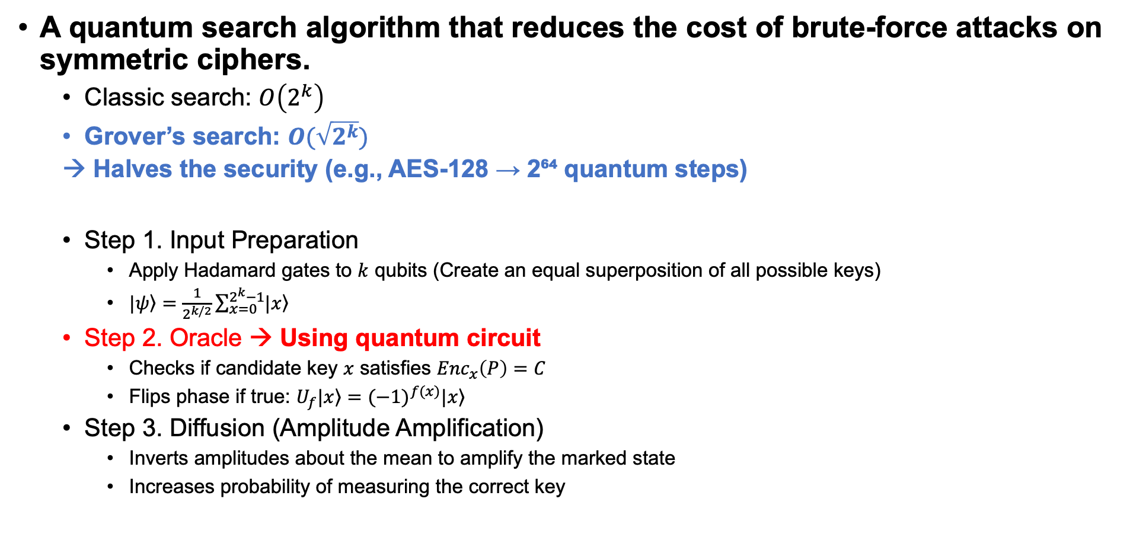
Background – Grover’s algorithm
A quantum search algorithm that reduces the cost of brute-force attacks on symmetric ciphers.
Classic search: $O\left(2^{k}\right)$
Grover’s search: $O(\sqrt{2^{k}})$
Halves the security (e.g., AES-128 → 2⁶⁴ quantum steps)
Step 1. Input Preparation
Apply Hadamard gates to $k$ qubits (Create an equal superposition of all possible keys)
$\left.|ψ\right\rangle =\frac{1}{2^{k/2}}\sum_{x=0}^{2^{k}−1}{\left.|x\right\rangle }$
Step 2. Oracle → Using quantum circuit
Checks if candidate key $x$ satisfies ${Enc}_{x}\left(P\right)=C$
Flips phase if true: $U_{f}\left.|x\right\rangle ={(−1)}^{f(x)}\left.|x\right\rangle$
Step 3. Diffusion (Amplitude Amplification)
Inverts amplitudes about the mean to amplify the marked state
Increases probability of measuring the correct key

Slide 5
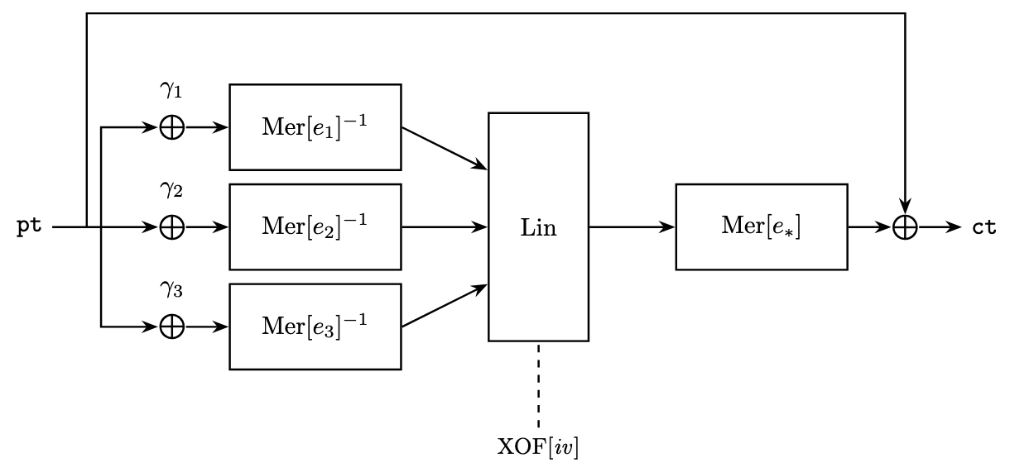

Background – AIM2
AIM2 is a tweakable one-way function designed for multi-target one-wayness.
Suitable for digital signature schemes, used in the AIMer signature proposal.
Construction combines:
non-linear operation: $Mer[e]$ 및 ${Mer}^{−1}[e]$ (Mersenne-type S-boxes)
Linear layer (Lin): constant addition, affine layer, feed-forward

Slide 6
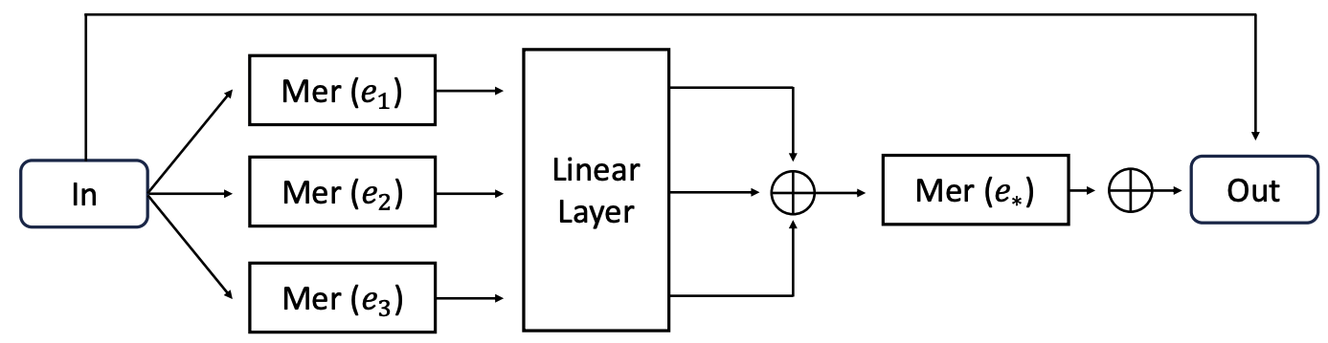
Background – AIM vs AIM2
AIM
AIM2

Slide 7
Background – AIM vs AIM2
AIM
AIM2

Slide 8
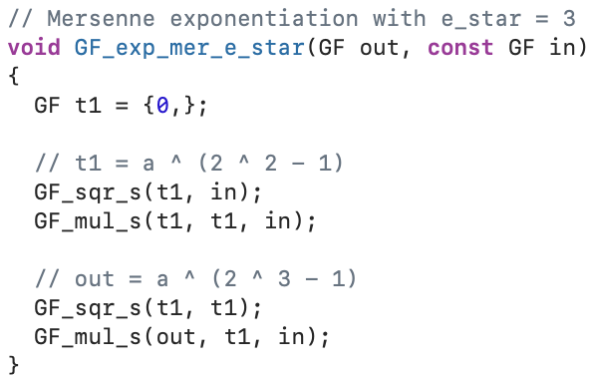
Background – $Mer$ function in AIM2

Slide 9
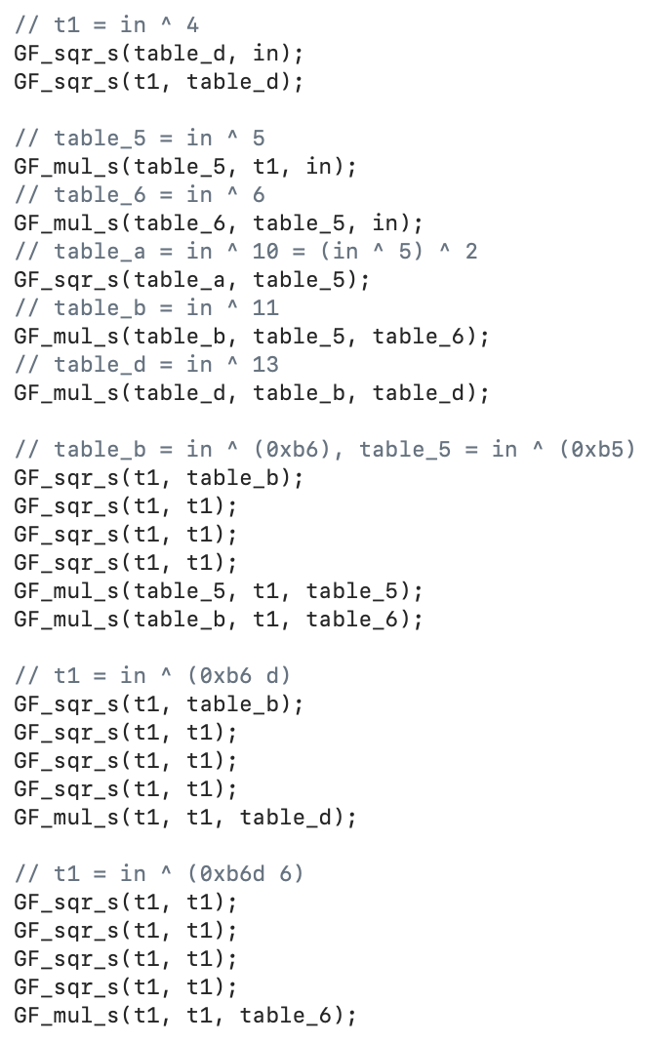
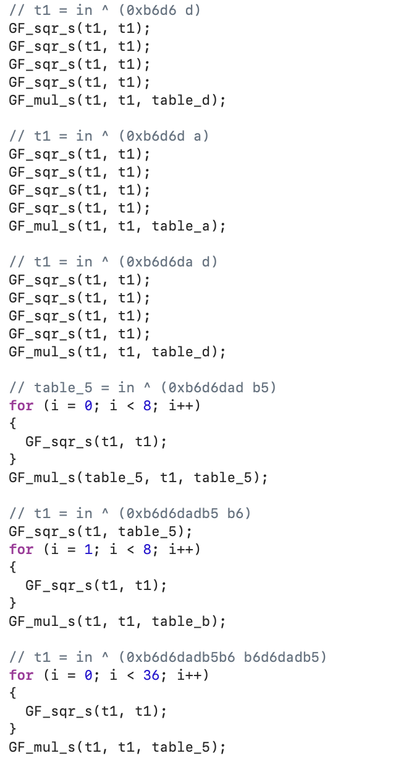
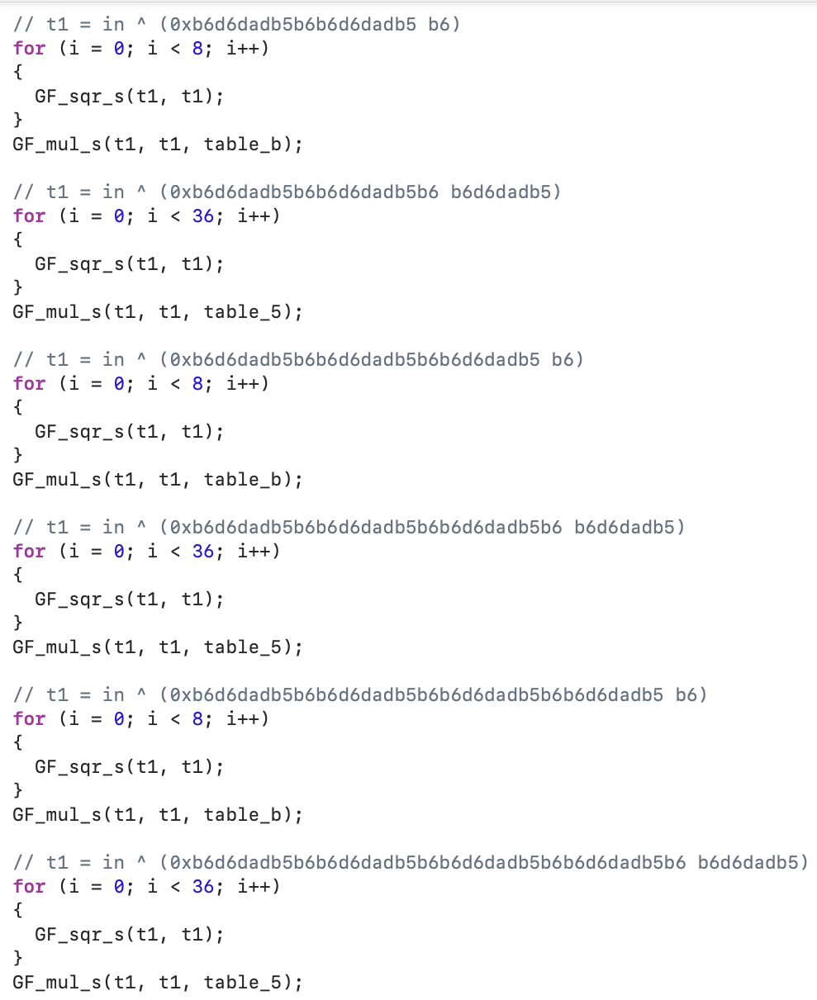
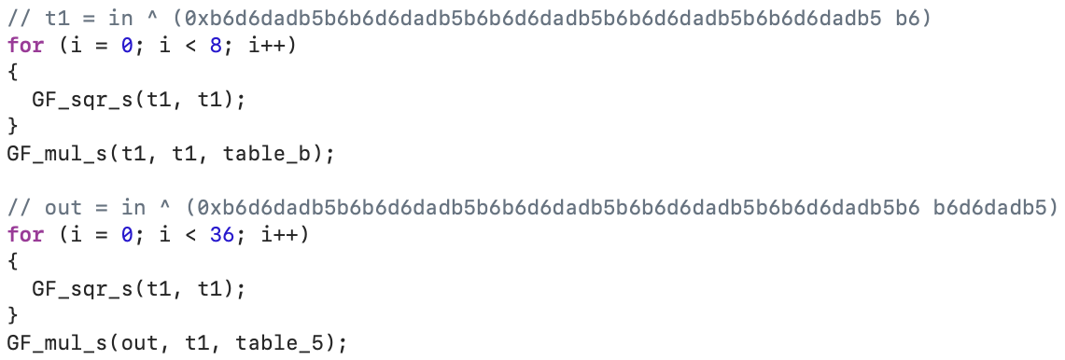
Background – ${Mer}^{−1}$ function in AIM2

Slide 10

Background – AIM2
AIM2-I
${Mer}^{−1}$(49), ${Mer}^{−1}$(91), Linear layer, $Mer$(3)
AIM2-III
${Mer}^{−1}$(17), ${Mer}^{−1}$(47), Linear layer, $Mer$(5)
AIM2-V
${Mer}^{−1}$(11), ${Mer}^{−1}$(141), Linear layer, ${Mer}^{−1}$(7), $Mer$(3)

Slide 11
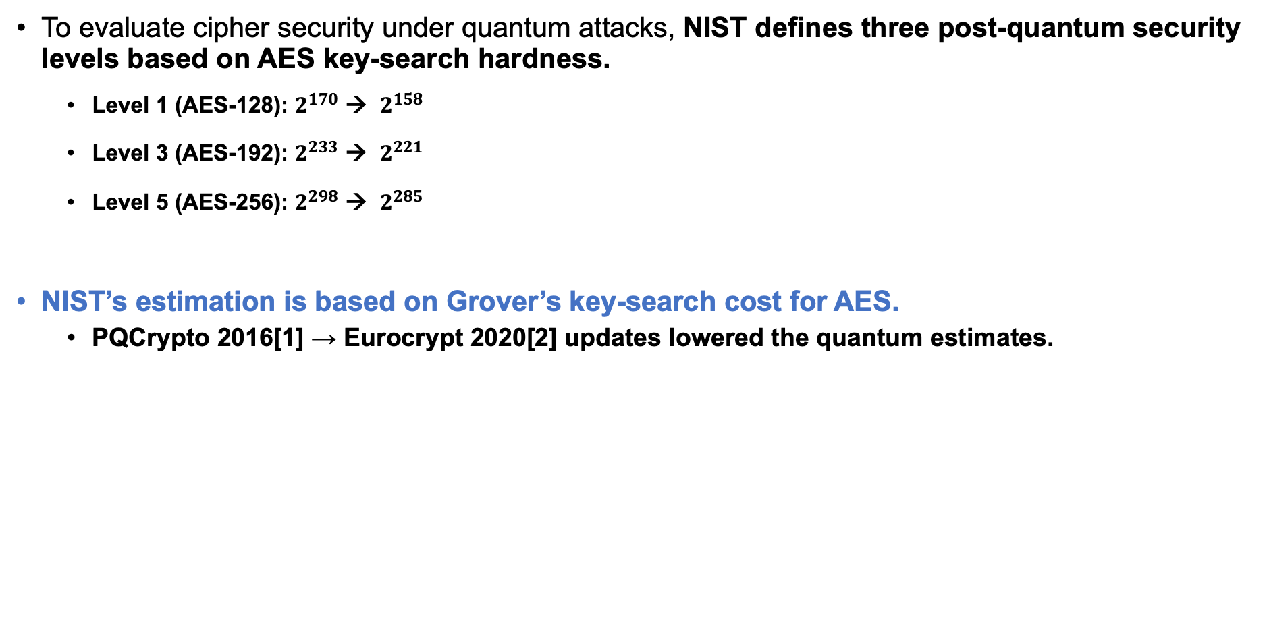
Background – NIST post-quantum security
To evaluate cipher security under quantum attacks, NIST defines three post-quantum security levels based on AES key-search hardness.
Level 1 (AES-128): $2^{170}$ → $2^{158}$
Level 3 (AES-192): $2^{233}$ → $2^{221}$
Level 5 (AES-256): $2^{298}$ → $2^{285}$
NIST’s estimation is based on Grover’s key-search cost for AES.
PQCrypto 2016[1] → Eurocrypt 2020[2] updates lowered the quantum estimates.
[1] Grassl, M., Langenberg, B., Roetteler, M., Steinwandt, R.: Applying Grover’s al- gorithm to AES: quantum resource estimates. In: International Workshop on Post- Quantum Cryptography. pp. 29–43. Springer (2016)
[2] Jaques, S., Naehrig, M., Roetteler, M., Virdia, F.: Implementing grover oracles for quantum key search on AES and LowMC. In: Annual International Conference on the Theory and Applications of Cryptographic Techniques. pp. 280–310. Springer (2020)

Slide 12
Quantum Circuit Implementation
&
Resource Analysis

Slide 13
Quantum circuit optimization for AIM2
Depth optimization
Using Low-depth multiplication and squaring modules as basic components.
Increased parallelism through optimized scheduling of multiplication and squaring operations.
Implemented parallel execution for sequential dependencies by copying intermediate operands (e.g., shared partial products).
Qubit optimization
Reused qubits generated from multiplication and squaring operations.
In Mer⁻¹ circuit, qubits used for sequential operations are cleaned up via inverse operations once their information is no longer needed, enabling qubit reuse without increasing circuit depth.

Slide 14
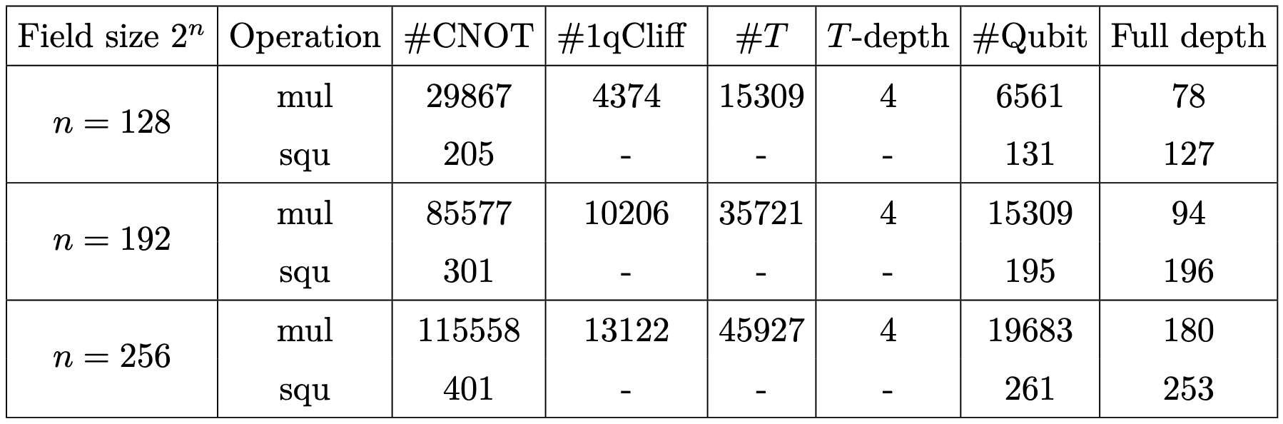
Components for quantum circuits
Multiplication: out-of-place quantum circuit (Karatsuba algorithm [1])
Squaring: In-place quantum circuit
→ Adopts Low-depth multiplication and squaring (same as in the previous AIM quantum circuit)
[1] Jang, K., Kim, W., Lim, S., Kang, Y., Yang, Y., Seo, H.: Optimized implementation of quantum binary field multiplication with toffoli depth one. In: International Conference on Information Security Applications. pp. 251–264. Springer (2022)

Slide 15
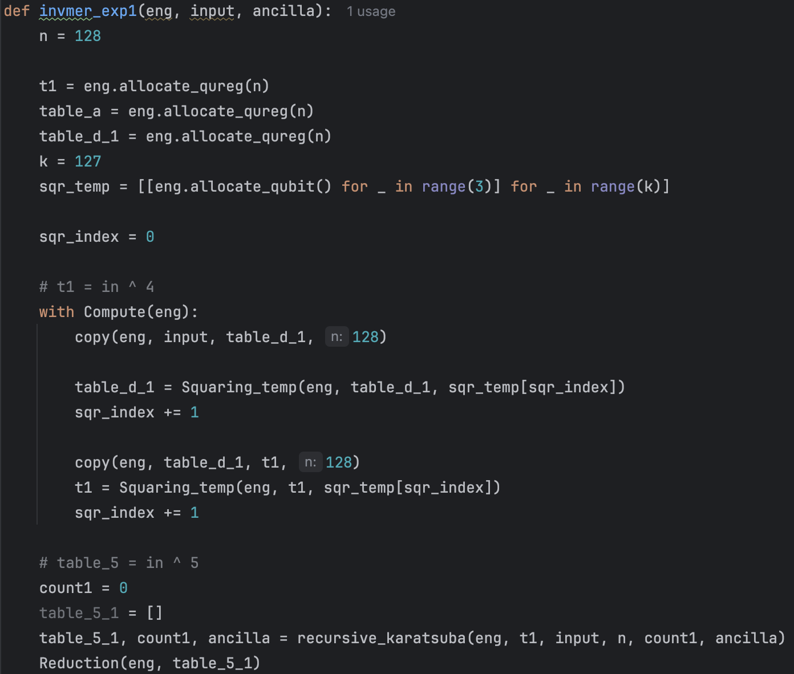
Quantum circuit for ${Mer}^{−1}$ (Qubit optimization)
In the Mer⁻¹ operation, intermediate values t1 and table_5 computed in lines 4–10 are no longer needed after line 31. (Algorithm 1)
These qubits can be reset in parallel and reused in the subsequent linear layer. (Qubit reuse to reduce ancilla)

Slide 16
Quantum circuit for ${Mer}^{−1}$ (Depth optimization)
# table_b = in ^ (0xb6), table_5 = in ^ (0xb5) for i in range(4): table_b = Squaring_temp(eng, table_b, sqr_temp[sqr_index])
sqr_index += 1 t1_copy = eng.allocate_qureg(len(table_b)) copy(eng, table_b, t1_copy, len(table_b)) count4_1 = 0 table_b_2 = [] table_b_2, count4_1, ancilla = recursive_karatsuba(eng, table_b, table_6, n, count4_1, ancilla) Reduction(eng, table_b_2) count4_2 = 0 table_5_2 = [] table_5_2, count4_2, ancilla = recursive_karatsuba(eng, t1_copy, table_5_1, n, count4_2, ancilla) Reduction(eng, table_5_2) copy(eng, table_b, t1_copy, len(table_b)) # t1_copy: clean-up Uncompute(eng) # # table_d_1: clean-up # # t1: clean-up
Multiplications at lines 26 and 29 both use the same input table_b → Normally sequential (Algorithm 1)
By applying fan-out to generate a temporary t1_copy, these multiplications are executed in parallel.
After finishing the multiplication, t1_copy ​ is reset (clean-up) and reused at line 32 (Algorithm 1).
t1_copy​ is later reused, so no additional qubit resources are consumed; only 2𝑛 CNOT gates are required, with a depth of 2.

Slide 17
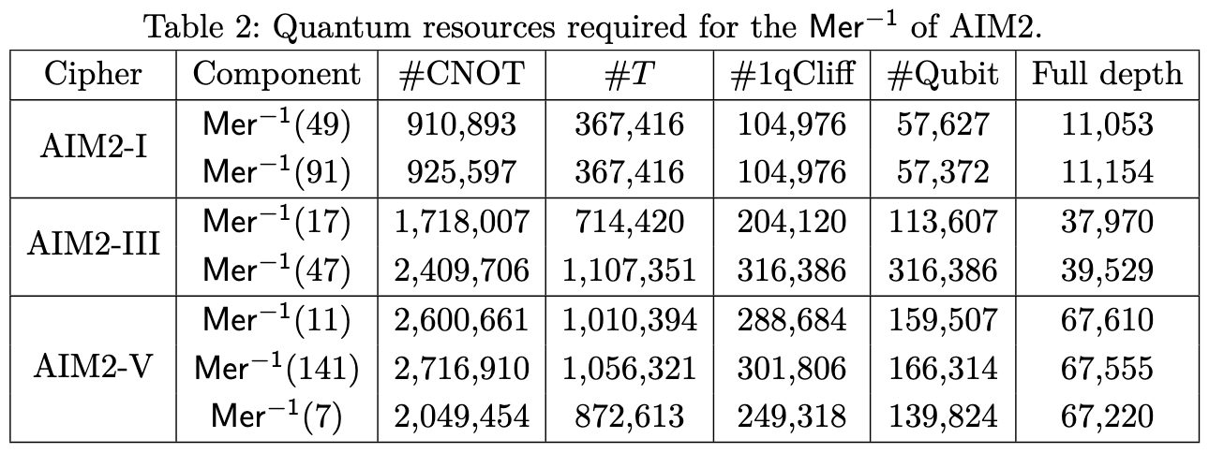
Resource Analysis of ${Mer}^{−1}$
In Mer⁻¹, a large number of multiplication and squaring operations are executed sequentially, resulting in a very large circuit depth.
Designed using out-of-place multiplication and in-place squaring.
Each AIM2 variant includes the following Mer⁻¹ exponentiation operations:
AIM2-I: Mer⁻¹(49), Mer⁻¹(91)
AIM2-III: Mer⁻¹(17), Mer⁻¹(47)
AIM2-V: Mer⁻¹(11), Mer⁻¹(141) , Mer⁻¹(7)

Slide 18
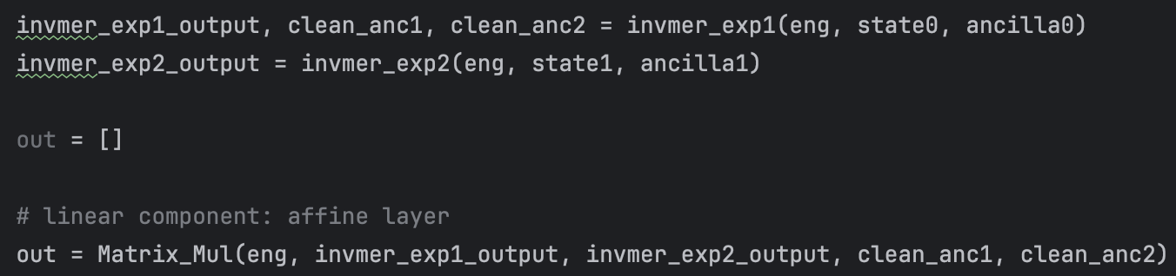
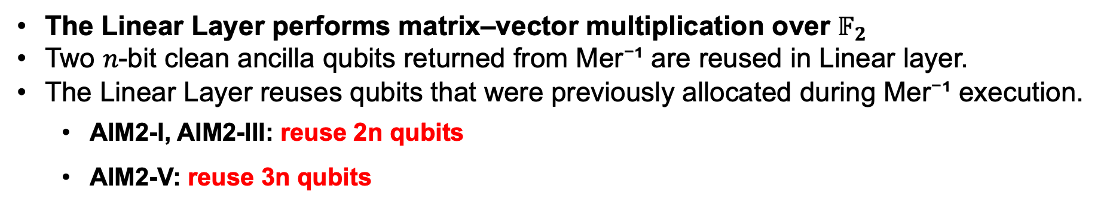
Quantum circuit for Linear Layer (Qubit optimization)
The Linear Layer performs matrix–vector multiplication over $𝔽_{2}$
Two 𝑛-bit clean ancilla qubits returned from Mer⁻¹ are reused in Linear layer.
The Linear Layer reuses qubits that were previously allocated during Mer⁻¹ execution.
AIM2-I, AIM2-III: reuse 2n qubits
AIM2-V: reuse 3n qubits
def Matrix_Mul(eng, state0, state1, temp_U0, temp_U1): n = 128 Matrix_Mul_General(eng, state0, temp_U0, matrix_U0) out1 = eng.allocate_qureg(n) Matrix_Mul_General(eng, temp_U0, out1, matrix_L0) Matrix_Mul_General(eng, state1, temp_U1, matrix_U1) temp_L1 = eng.allocate_qureg(n) Matrix_Mul_General(eng, temp_U1, temp_L1, matrix_L1) for i in range(n): CNOT | (temp_L1[i], out1[i]) return out1

Slide 19
Quantum circuit for Linear Layer (Optimization)
The Linear Layer multiplies the input vector by a predefined binary matrix.
This matrix is derived from the hash input using:
SHAKE-128 for AIM-I
SHAKE-256 for AIM-III and AIM-V
Therefore, the operation is a classical(matrix vector)-quantum.
def Matrix_Mul(eng, state0, state1, temp_U0, temp_U1): n = 128 Matrix_Mul_General(eng, state0, temp_U0, matrix_U0) out1 = eng.allocate_qureg(n) Matrix_Mul_General(eng, temp_U0, out1, matrix_L0) Matrix_Mul_General(eng, state1, temp_U1, matrix_U1) temp_L1 = eng.allocate_qureg(n) Matrix_Mul_General(eng, temp_U1, temp_L1, matrix_L1) for i in range(n): CNOT | (temp_L1[i], out1[i]) return out1
def Matrix_Mul_General(eng, input_qubits, output_qubits, matrix): for i in range(128): for j in range(128): if ((matrix[j] >> i) & 1): CNOT | (input_qubits[j], output_qubits[i])

Slide 20
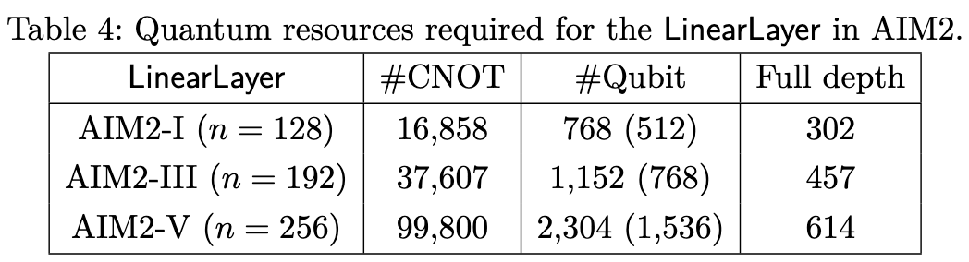
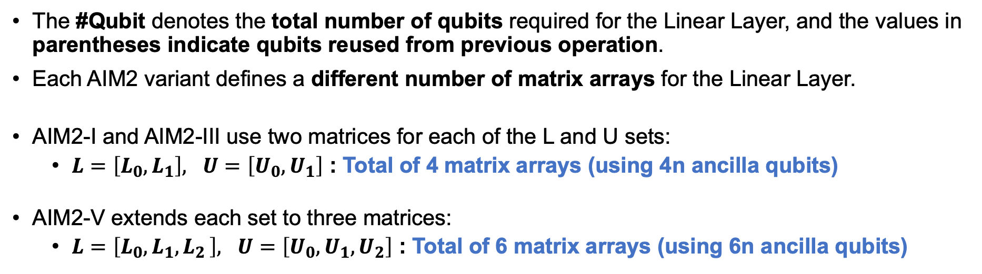
Resource Analysis of Linear layer
The #Qubit denotes the total number of qubits required for the Linear Layer, and the values in parentheses indicate qubits reused from previous operation.
Each AIM2 variant defines a different number of matrix arrays for the Linear Layer.
AIM2-I and AIM2-III use two matrices for each of the L and U sets:
$L=\left[L_{0}, L_{1}\right], U=\left[U_{0}, U_{1}\right]$ : Total of 4 matrix arrays (using 4n ancilla qubits)
AIM2-V extends each set to three matrices:
$L=\left[L_{0}, L_{1}{, L}_{2}\right], U=\left[U_{0}, U_{1}, U_{2}\right]$ : Total of 6 matrix arrays (using 6n ancilla qubits)

Slide 21
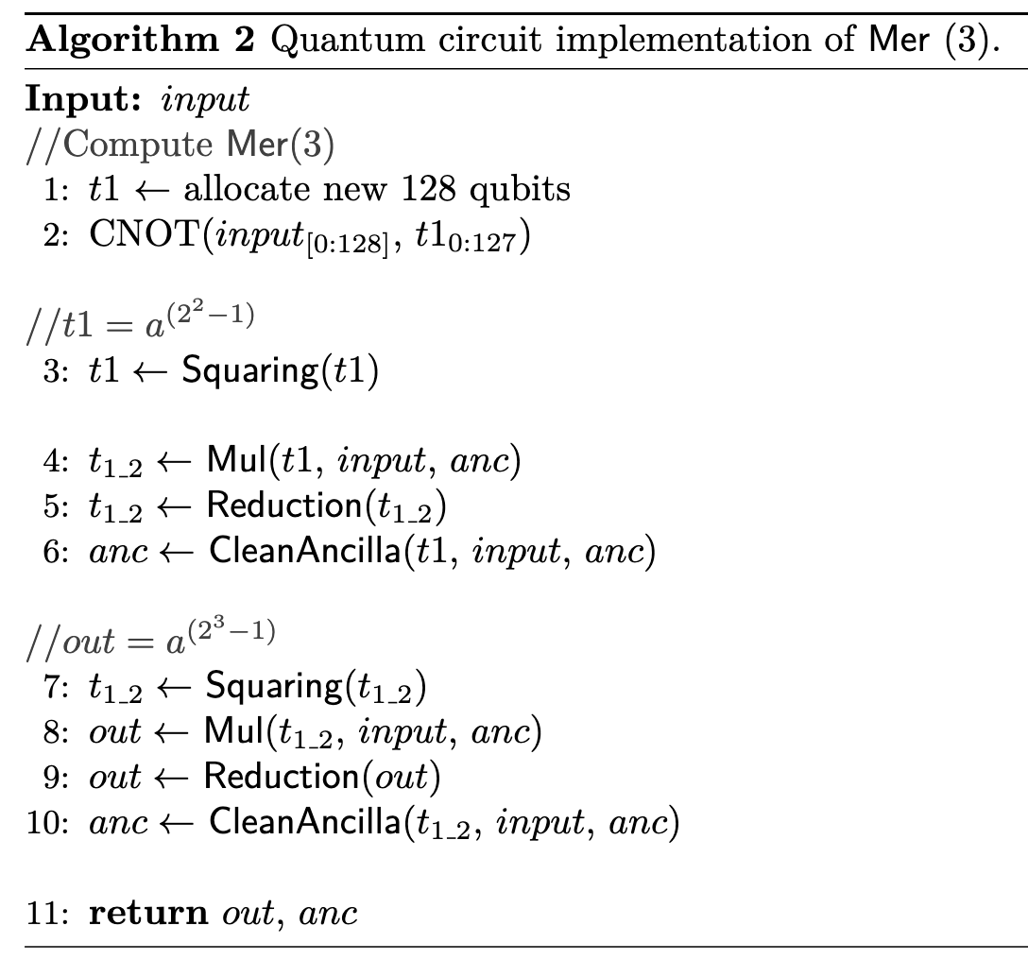
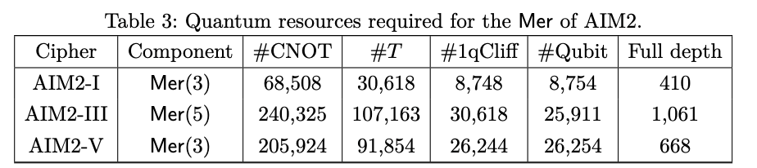

Quantum circuit for $Mer$
$Mer$ is a non-linear transformation consisting of multiple multiplications and squarings.
Compared to Mer⁻¹, the Mer operation involves fewer computations and therefore consumes fewer quantum resources.

Slide 22
Evaluation

Slide 23
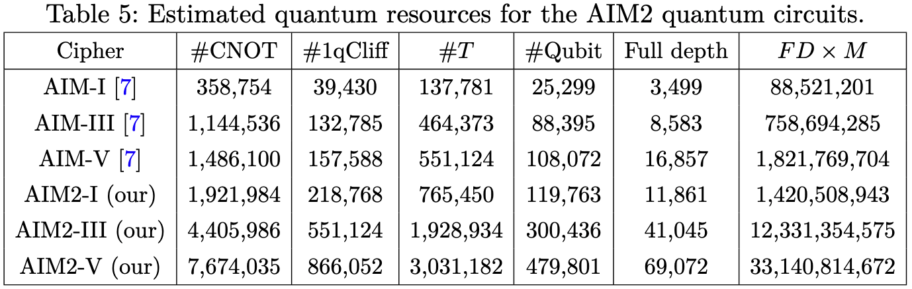
Evaluation – AIM vs AIM2
We evaluate the post-quantum security of AIM2 by analyzing its quantum resource requirements.
Key design difference:
AIM: Mer before and after the linear layer
AIM2: Mer⁻¹ before the linear layer, Mer afterwards (with optimization)
Since Mer⁻¹ is significantly more expensive than Mer, AIM2 circuits require more resources than AIM.
[7] Jang, K., Oh, Y., Kim, H., Seo, H.: Quantum implementation of AIM: aiming for low-depth. Applied Sciences 14(7), 2824 (2024)

Slide 24
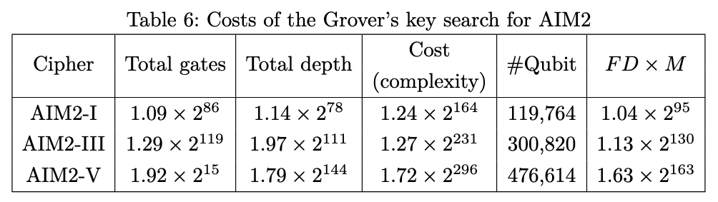
Evaluation – AIM2 Grover cost
We estimate the Grover search cost of AIM2.
Grover Oracle Cost Model
Oracle =
AIM2 quantum encryption circuit
n-controlled NOT for ciphertext comparison
inverse AIM2 circuit
Grover complexity grows with parameter size.
These values will be used to determine whether AIM2 meets NIST PQC security levels.

Slide 25
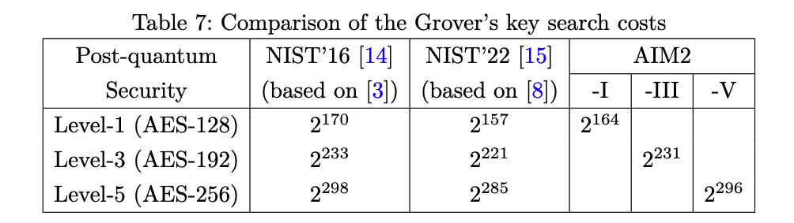
Evaluation – AIM2 post-quantum security
We compare the Grover key-search cost of AIM2 with NIST’s Post-Quantum security levels.
NIST originally provided estimates in 2016, but these were revised in 2022 due to updated AES Grover cost results.
AIM2 is evaluated against updated NIST’22 values for a fair comparison.
Using the revised estimates, AIM2-I, AIM2-III, and AIM2-V meet the Post-Quantum security levels 1, 3, and 5, respectively.
[14] NIST.: Submission requirements and evaluation criteria for the post- quantum cryptography standardization process (2016), https://csrc. nist.gov/CSRC/media/Projects/Post-Quantum-Cryptography/documents/ call-for-proposals-final-dec-2016.pdf
[15] NIST.: Call for additional digital signature schemes for the post-quantum cryp- tography standardization process (2022), https://csrc.nist.gov/csrc/media/ Projects/pqc-dig-sig/documents/call-for-proposals-dig-sig-sept-2022. pdf
[3] Grassl, M., Langenberg, B., Roetteler, M., Steinwandt, R.: Applying Grover’s al- gorithm to AES: quantum resource estimates. In: International Workshop on Post- Quantum Cryptography. pp. 29–43. Springer (2016)
[8] Jaques, S., Naehrig, M., Roetteler, M., Virdia, F.: Implementing grover oracles for quantum key search on AES and LowMC. In: Annual International Conference on the Theory and Applications of Cryptographic Techniques. pp. 280–310. Springer (2020)

Slide 26
Conclusion
In this work, we proposed quantum circuit implementations of AIM2.
For all AIM2 variants (AIM-I, AIM-III, AIM-V), we optimized quantum circuits for the internal operations
Based on the proposed circuits, we estimate the cost of Grover’s algorithm for key search and confirm post-quantum security levels.
As a result, AIM2-I, -III, and -V meet Level-1, -3, and -5 security levels.
These results show that AIM2 provides strong post-quantum security.

